Slide 1
Predicting Credit Card Approval of Customers using Machine Learning Algorithms CIND 820 – Big Data Analytics Project
Prabhkiran Kang
Student Number: 501068149

Slide 2
Contents
Introduction
Problem Statement
Past Findings
Dataset
My approach
Data Exploration
Data Preprocessing and Feature Engineering
Machine Learning Models
Conclusion
Summary

Slide 3

Introduction
Nowadays, almost everything in our daily life is transitioning to digital world. This also includes cashless transaction activities.
Credit cards have become one of the most popular modes of payment for electronic transactions. However, as the number of credit card users are increasing exponentially, so are the credit card frauds.
The correct assessment for credit card approval is very important for financial institutions. A wide range of machine learning techniques have been developed to solve credit card related problems.

Slide 4

Problem Statement
The objective of this project is to use the historical data and machine learning algorithms to predict if a customer’s credit card application would be accepted or rejected. I would identify the most efficient and best performing model that can be used to predict the approval of credit cards based on the attributes of the credit card application.

Slide 5
Past Findings
In the past, work has been done on similar research problem and dataset. Authors of research papers have applied different machine learning algorithms and compared the accuracy of the models to identify the most effective one.
Algorithms used were Logistic Regression, SVM, KNN, Decision Tree, Random Forest and Light Gradient Boosting Machine (LGBM), CART Model.
Evaluation metrics used were Precision, Recall, Time, Accuracy, F1-Score.
Therefore, after reading the papers, I observed that solving this problem has many approaches, and every model applied would lead to prediction with different accuracies.

Slide 6
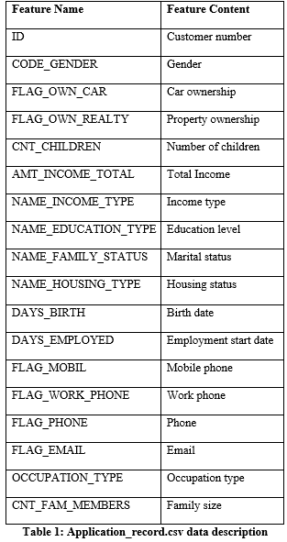
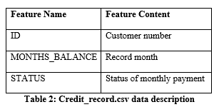
Dataset
The data set is from Kaggle Inc. website, consists of two csv files: application_record.csv and credit_record.csv.
File#1: Application_record.csv consists of personal information of the customers.
Total Features/Columns: 18
Total Rows: 438,557
File#2: Credit_record.csv consists of credit card user’s behavior pattern.
Total Features/Columns: 3
Total Rows: 1,048,575

Slide 7
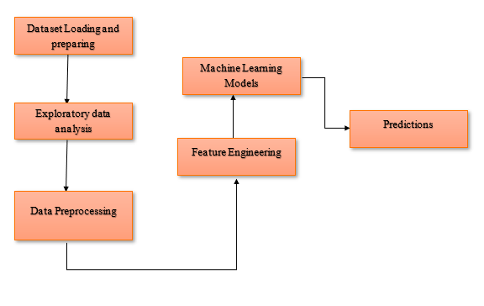
My Approach

Slide 8
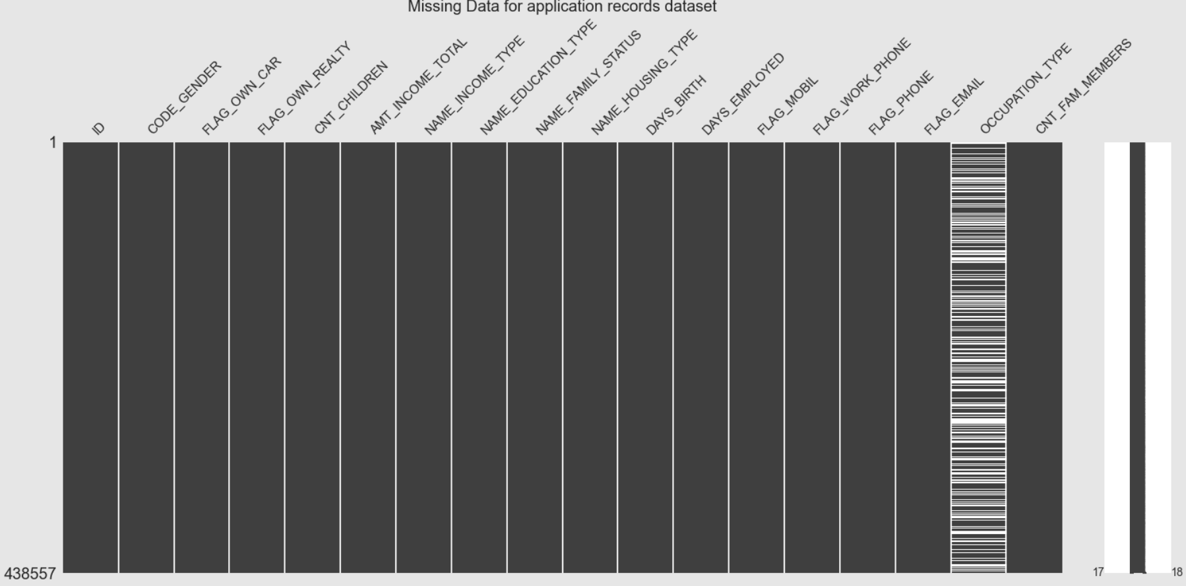
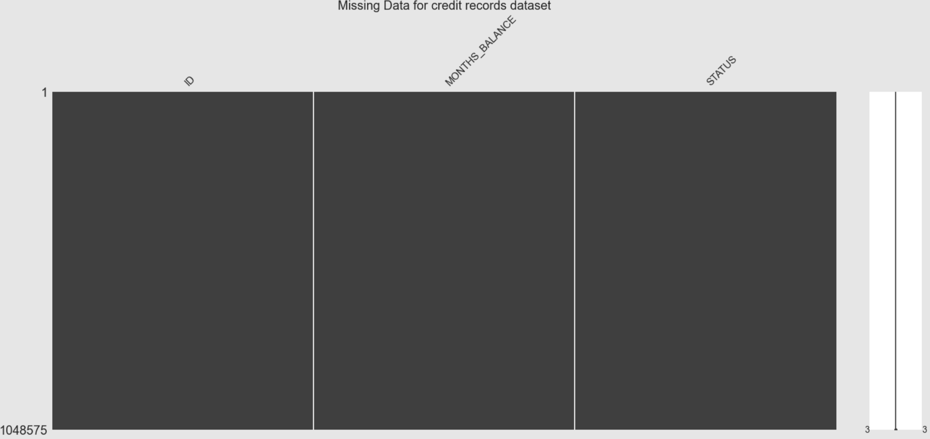
Data Exploration
I explored each csv file individually.
application record csv file: Number of unique clients and number of rows are not equal. Occupation_Type feature has lot of missing values
credit record csv file: Number of unique clients are less than # rows. No missing data found.

Slide 9
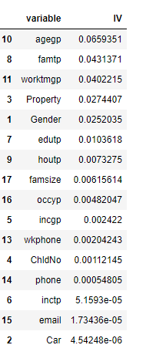
Data Preprocessing and Feature Engineering
Data Preprocessing: I analyzed, cleaned, and transformed all of the features to use them in the Prediction Models.
Created a target variable, renamed columns and removed null values.
Feature Engineering: I calculated the Information Value (IV) of the features, to select important variables.

Slide 10


Machine Learning Models
Classification Models used:
Logistic Regression
Decision Tree
Random Forest
Support vector machine (SVM)
XGBOOST
K-Nearest Neighbor (KNN)
Evaluation Metrics used:
Confusion Matrix
Precision
Recall
F-1 Score
Accuracy
AUC Score

Slide 11
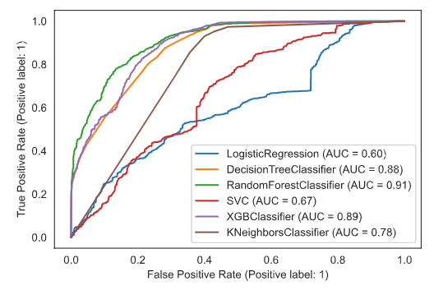
Conclusion
Random Forest model gives the best accuracy score. Thus, it is the most efficient and best performing model.

Slide 12
Goal: To use the historical data and machine learning algorithms to predict if a customer’s credit card application would be accepted or rejected. Approach: I applied six different classification algorithms to the dataset to find out which model gives the most accurate prediction results. I applied the Synthetic Minority Oversampling Technique (SMOTE), to stabilize the imbalanced data. Findings: Random Forest classification model gives the most accurate prediction. Future Improvement: Apply other classification models to improve the accuracy score.
Summary

Slide 13


